Slide 1
Color Transfer between Images
0556097 陳威翔
0556562 陳鴻君

Slide 2
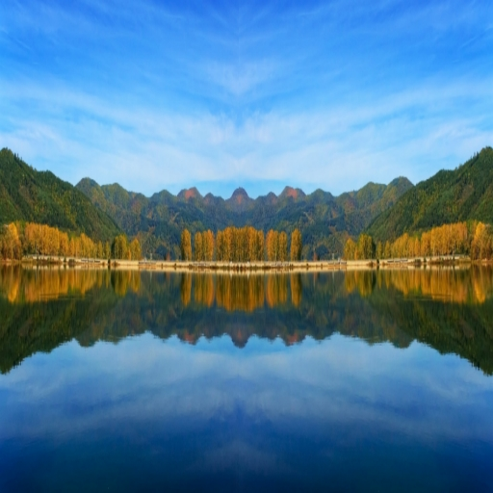
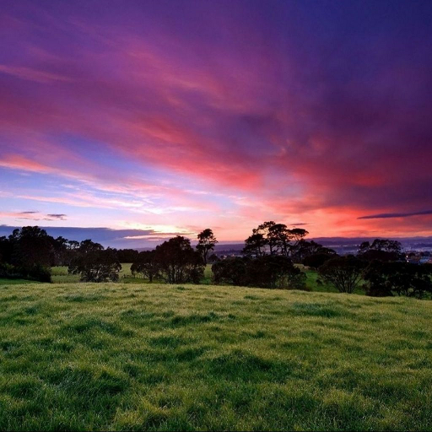
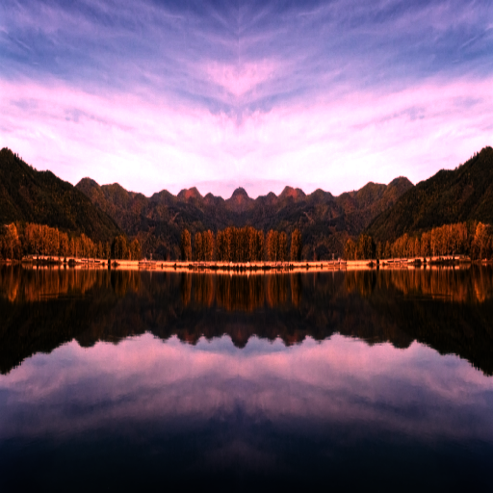
Color Transfer
A method that borrows one image’s color characteristics from another.
Source image : the original (standard image).
Target image : the colors of an image intends to be altered.
+
=
Source
Target
Result

Slide 3
Color Transfer Algorithm
A three steps approaches with two images, the source and the target image.
Need to perform several color space conversions.
Step1: Forwardly convert pixels in the RGB color space to the 𝒍𝜶𝜷 color space.
Step2: Statistically process each pixel of the image in the 𝒍𝜶𝜷 color space and generate the corresponding result pixel.
Step3: Reversely convert result pixels back to the RGB color space.

Slide 4
Step1: Forward Color Space Conversion
Goal: convert each pixel in the RGB color space to the 𝒍𝜶𝜷 color space.
Apply to both source and target images.
Four sub-steps are recommended.
RGB → 𝒍𝜶𝜷
1.1 RGB → XYZ
1.2 XYZ → LMS
1.3 LMS → LMS
1.4 LMS → 𝒍𝜶𝜷
Notes:
Ruderman et al. proceed to decorrelate these axes. Their motivation was to better understand the human visual system, which they assumed would attempt to process input signals similarly.
Thus the l axis represents an achromatic channel, while the α and β channels are chromatic yellow–blue and red–green opponent channels. The data in this space are symmetrical and compact, while we achieve decorrelation to higher than second order for the set of natural images tested.2 Flanagan et al.5 mentioned this color space earlier because, in this color space, the achromatic axis is orthogonal to the equiluminant plane. Our color-correction method operates in this lαβ space because decorrelation lets us treat the three color channels separately, simplifying the method.

Slide 5
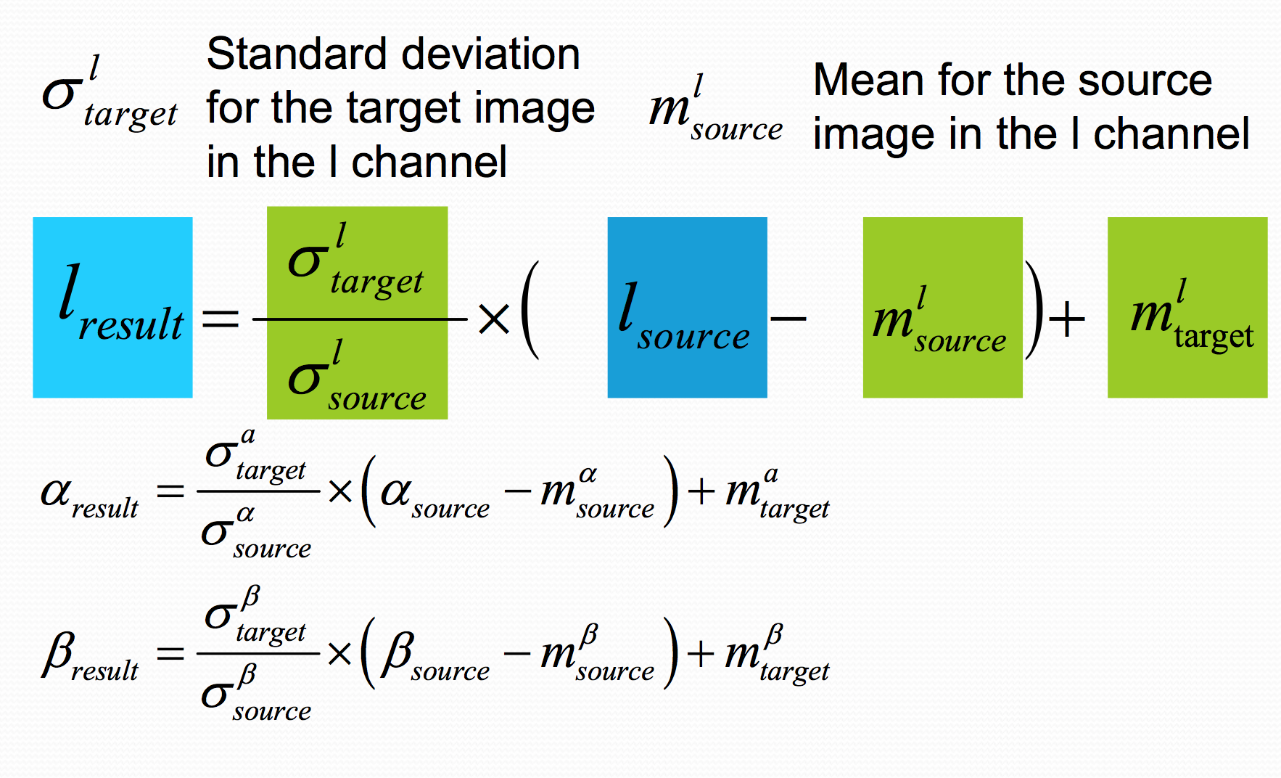
Step2: Statistical pixel processing
Notes:
The goal of our work is to make a synthetic image take on another image’s look and feel. More formally this means that we would like some aspects of the distribution of data points in lαβ space to transfer between images. For our purposes, the mean and standard deviations along each of the three axes suffice.
First, we subtract the mean from the data points
Then, we scale the data points comprising the synthetic image by factors determined by the respective standard deviations

Slide 6
Step3: Reverse Color Space conversion
𝒍𝜶𝜷 → RGB
3.1 𝒍𝜶𝜷 → LMS
3.2 LMS → LMS
3.3 LMS → XYZ → RGB

Slide 7
Use openMP to parallelize
設備：i7-6800K CPU, 32GB RAM (6 cores, 12 threads).
Method 1: use parallel for to parallelize
Method 2: 先把local的mean & standard deviation做完再更新到global的mean & standard deviation
結論：thread同步的overhead筆method 1 少一些，speedup會因此進步一點
限制：須依照圖片大小和thread個數分配
Notes:
CPU : 6 cores, 12 threads

Slide 8
Compare different size
 | 512*512 | 1024*1024 | 2048*2048 | 4096*4096
1 | 0.206 | 1.042 | 4.034 | 17.251
2 | 0.131 | 0.663 | 2.589 | 11.2
4 | 0.09 | 0.455 | 1.842 | 8.061
8 | 0.085 | 0.436 | 1.709 | 7.533
 | 512*512 | 1024*1024 | 2048*2048 | 4096*4096
1 | 1 | 1 | 1 | 1
2 | 1.5725 | 1.5716 | 1.5581 | 1.5
4 | 2.2889 | 2.2901 | 2.19 | 2.14
8 | 2.4235 | 2.3899 | 2.3604 | 2.29

Slide 9
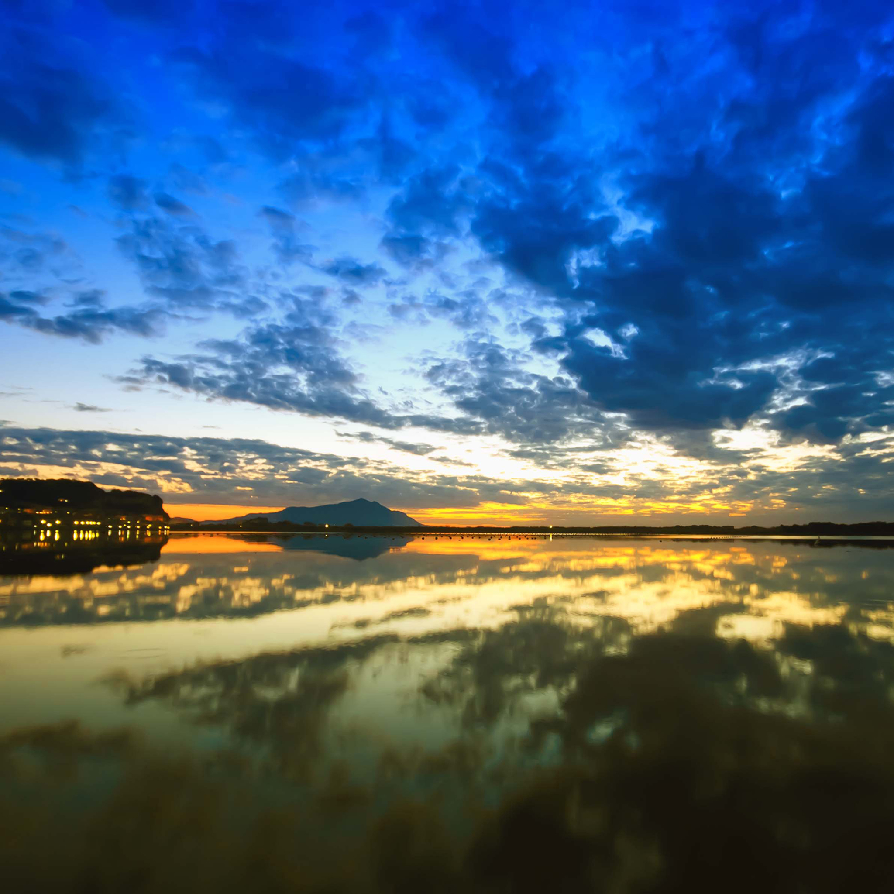
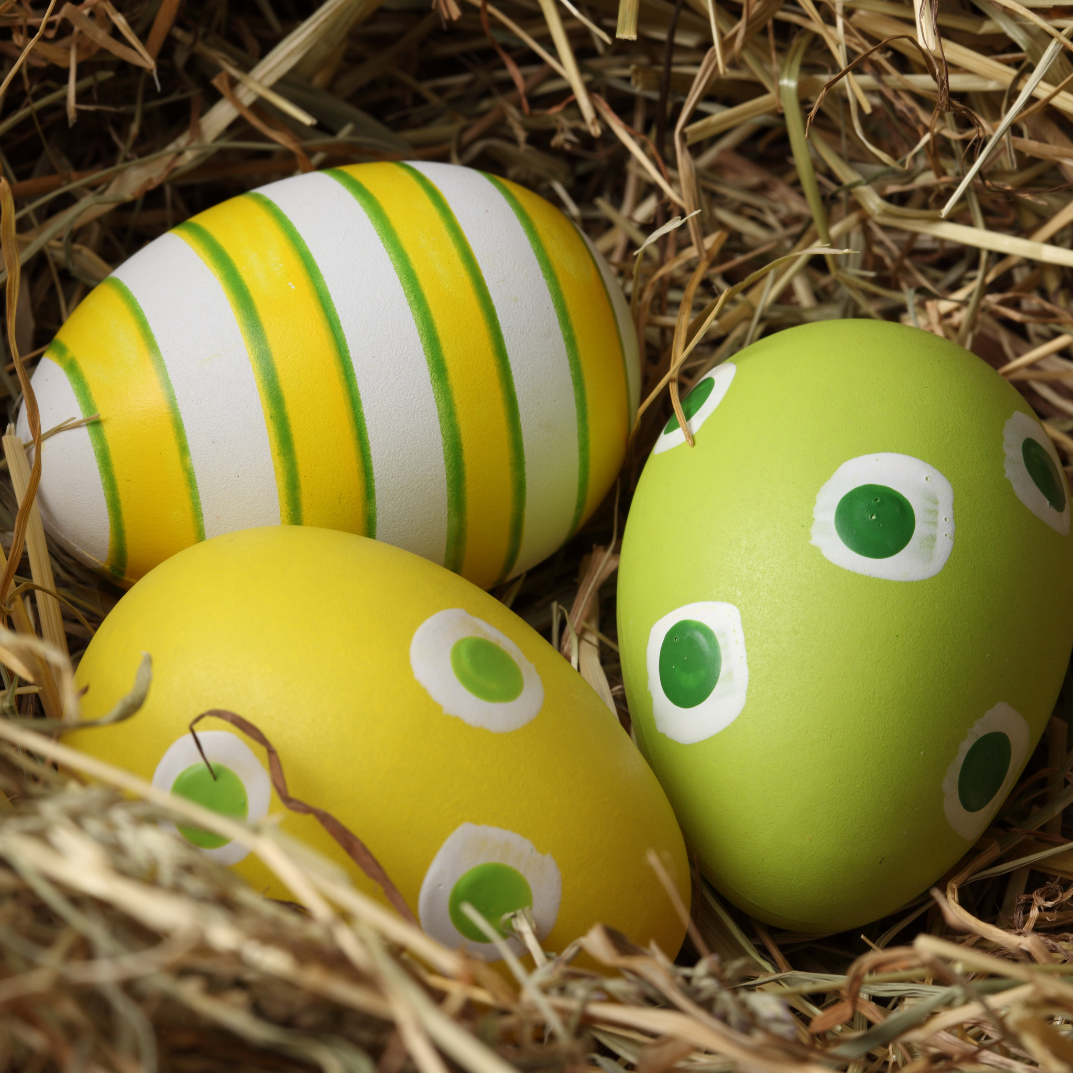
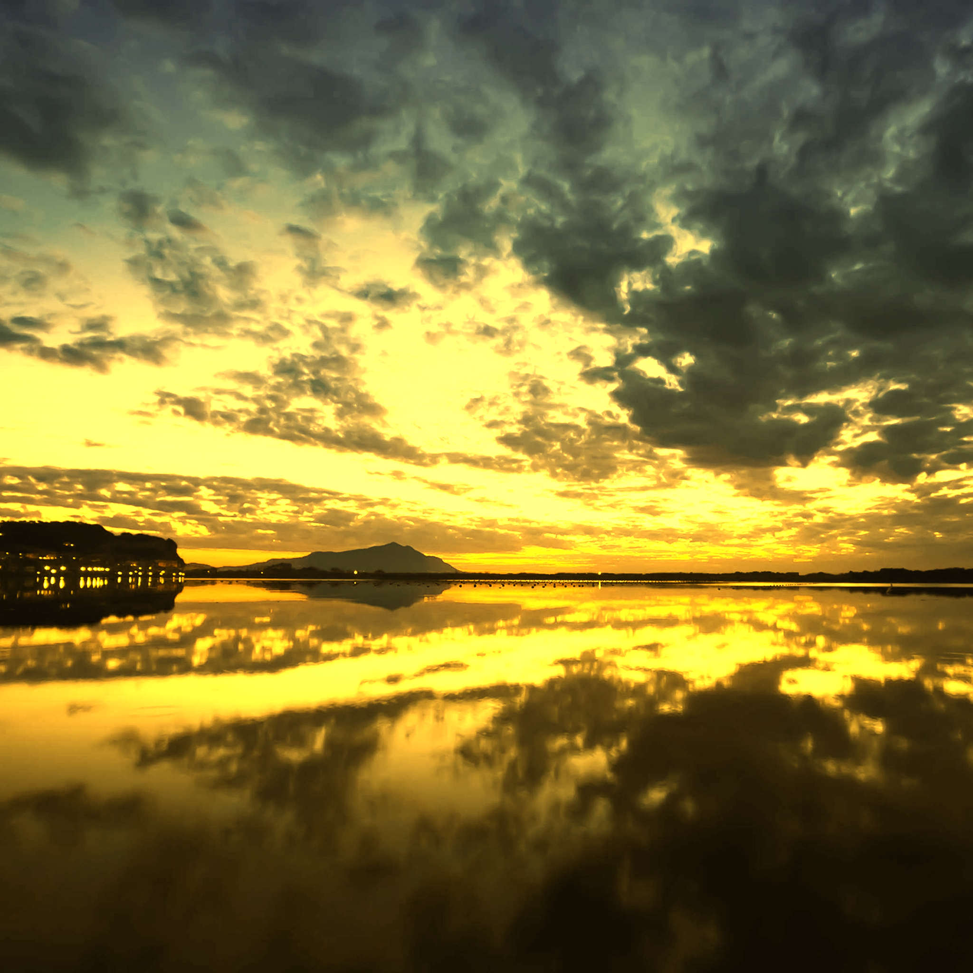
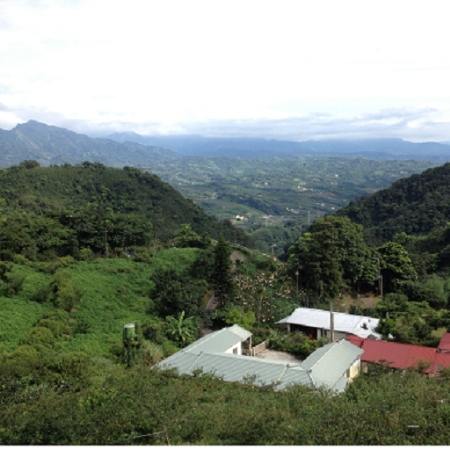
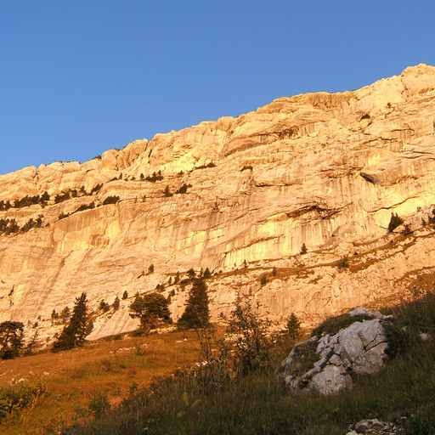
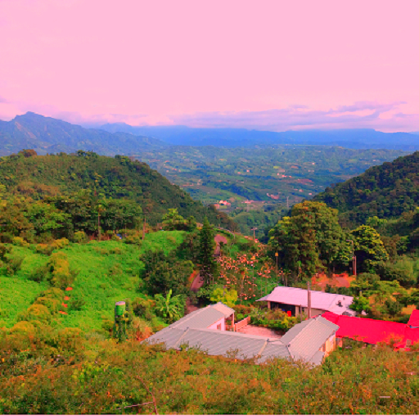
Result
+
=
+
=

Slide 10
Thank you for listening

